Slide 1

AWS CLOUD & NETWORK SECURITY
Presented by
Y. Kranthi (16A95a0436)
N. Sudha (15A91A04G1)
B. Amit (15A91A04C3)
G.Indrani (16A95A0429)
Under the Esteemed Guidance of
P Bala Srinivas Asst Professor

Slide 2
CONTENTS
Introduction
Issues in implementation
Objective
S/W,H/W and services requirements
Advantages of proposed approach
Block Diagram
Applications
Conclusion
Future work
References

Slide 3



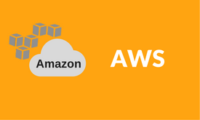
Platforms
AWS
IoT
Network Security

Slide 4

PR0JECT ROADMAP
MILESTONE TITLE
Load Balencer
Milestone description
Milestone description
AWS
EC2
LINUX
LB
Auto
Scaling
MILESTONE TITLE
MILESTONE TITLE
IoT
Milestone description
Milestone description
MILESTONE TITLE
MILESTONE TITLE
Milestone description
Milestone description
IOT WEB PAGE
DB
SERVER
MQTT
Sensors Data
3 Platforms Plan
NW
SEC
MILESTONE TITLE
MILESTONE TITLE
Milestone description
Milestone description
MILESTONE TITLE
MILESTONE TITLE
Milestone description
Milestone description
VPN
Layer 2 securiy
Firewall
IPS
MILESTONE TITLE
MILESTONE TITLE
Milestone description
Milestone description
20XX

Slide 5
Introduction:
This project main aim is to handle thousands of requests(IOT and Web traffic load) on a web portal. When the user hits on a certain url and if the requests are more on the url the traffic load will be more. There will be lagging of the site and can’t be accessed.
Due to this in commercial sites, there will be unavailability of the url, to avoid this problem we are going to change the existing policies in AWS Cloud, and create virtual data servers by using AWS Service. When the usage is normal we are going to reduce the created virtual servers but the existence of the url will not be lost.
Network security consists of the policies and practices to prevent and monitor unauthorized access, misuse, modification, or denial of a computer network and network-accessible resources.
Only Network security can protect you from Trojan horse viruses. Network security involves the authorization of access to data in a system, controlled by the network administrator.

Slide 6
Issues in implementation:
Unavailability of the website when the requests from users increases on the website.
It costs more for maintaining physical servers so creating virtual servers using AWS services costs low.
Security is low for networking devices.

Slide 7
Objective
Nowadays, the E-commerce website is top-rated, the Online shopping sites are increased. These websites requesting (or) accessing data will be different day today. For suppose from monday-friday these sites will get approximately 10,000 requests.
Only on weekends, the requests may increase to 50,000, on festivals and big billion days, they will get lakhs of requests. We have to maintain servers, applications, storage, etc for these sites.
On weekdays load will be normal, So it may require 2 or 3 servers and on weekends we need 10 to 100 servers besides. On offer’s day, we have to maintain thousands of servers.
Mainatinence of servers is dificult. This much of infra of websites building and managing, it is challenging. To overcome this issue, we are moving to the cloud. That is AWS CLOUD, and it is providing a feature called load balancing and Auto scaling.

Slide 8
Hardware ,Software,Services used:
AWS(Cloud Watch,VPC,EC2,LINUX,S3,SSH)
Scripting Languages (Json)
Cisco Networking devices (Router, Switch)
Load Balancing provided by AWS.
Auto Scaling provided by AWS.

Slide 9
Advantages of proposed approach:
Handling millions of requests without any down time.
Automatic server allocation will be possible without user interaction.
Maintenance cost will be reduced with AWS.
Layer 2 attacks like ARP SPOOFING, MAC FLOODING, and DHCP SPOOFING will be prevented.
To connect different branches with security, we are implementing SITE TO SITE VPN.

Slide 10


Elastic Load Balancing
Distributes traffic across multiple EC2 instances, in multiple Availability Zones
Supports health checks to detect unhealthy
Amazon EC2 instances
Supports the routing and load balancing of HTTP, HTTPS, SSL, and TCP traffic to Amazon EC2 instances
Elastic Load Balancing
© 2018, Amazon Web Services, Inc. or its Affiliates. All rights reserved.

Slide 11



Classic Load Balancer – How It Works
Register instances with your load balancer.
load balancer
X
Availability Zone A
Availability Zone B
© 2018, Amazon Web Services, Inc. or its Affiliates. All rights reserved.

Slide 12



































Application Load Balance – How It Works
Register instances as targets in a target group, and route traffic to a target group.
load balancer
Rule
Listener
Rule
Listener
Rule
Target Target
Target
Target
Target
Target
Target
Target Group
Health Check
Target Group /api
Health Check
Target Group /mobile
Health Check
© 2018, Amazon Web Services, Inc. or its Affiliates. All rights reserved.

Slide 13
Amazon CloudWatch
A monitoring service for AWS cloud resources and the applications you run on AWS
Visibility into resource utilization, operational performance, and overall demand patterns
Custom application-specific metrics of your own
Accessible via AWS Management Console, APIs, SDK, or CLI
Amazon
CloudWatch
© 2018, Amazon Web Services, Inc. or its Affiliates. All rights reserved.

Slide 14
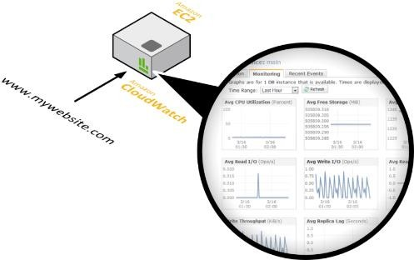

Amazon CloudWatch Facts
Monitor other AWS resources
View graphics and statistics
Set Alarms
© 2018, Amazon Web Services, Inc. or its Affiliates. All rights reserved.

Slide 15
























Amazon CloudWatch Architecture
Amazon CloudWatch
AWS resources that support CloudWatch
Amazon CloudWatch Alarm
SNS Email Notification
CPUUtilization
StatusCheckFailed
PageViewCount
Available Statistics
Custom Application- Specific Metrics
CloudWatch Metrics
Auto Scaling
AWS Management Console
Statistics Consumer
© 2018, Amazon Web Services, Inc. or its Affiliates. All rights reserved.

Slide 16

Auto Scaling
Scale your Amazon EC2 capacity automatically
Well-suited for applications that experience variability in usage
Available at no additional charge
Auto
Scaling
© 2018, Amazon Web Services, Inc. or its Affiliates. All rights reserved.

Slide 17

Launch Configurations
A launch configuration is a template that an Auto Scaling
group uses to launch EC2 instances.
When you create a launch configuration, you can specify:
AMI ID
Instance type
Key pair
Security groups
Block device mapping
User data
© 2018, Amazon Web Services, Inc. or its Affiliates. All rights reserved.

Slide 18





Auto Scaling Groups
Contain a collection of EC2 instances that share similar characteristics.
Instances in an Auto Scaling group are treated as a logical grouping for the purpose of instance scaling and management.
Auto Scaling group
Minimum size
Scale out as needed
Desired capacity
Maximum size
© 2018, Amazon Web Services, Inc. or its Affiliates. All rights reserved.

Slide 19







Auto Scaling Basic Lifecycle
Scale Out
Launch Instance
instances
Auto Scaling group
Scheduled Event
Amazon CloudWatch
© 2018, Amazon Web Services, Inc. or its Affiliates. All rights reserved.

Slide 20

Auto Scaling Basic Lifecycle
Attach to Group
Scale Out
Launch Instance
instances
Auto Scaling group
Scheduled Event
Amazon CloudWatch
© 2018, Amazon Web Services, Inc. or its Affiliates. All rights reserved.

Slide 21



AWS Block Diagram
Elastic Load Balancing
Latency
Utilization
Auto Scaling group
Auto Scaling
CloudWatch
© 2018, Amazon Web Services, Inc. or its Affiliates. All rights reserved.

Slide 22
Cont..
Elastic Load
Balancing
Latency
Utilization
Auto Scaling group
Execute AS Policy
Auto Scaling

Slide 23


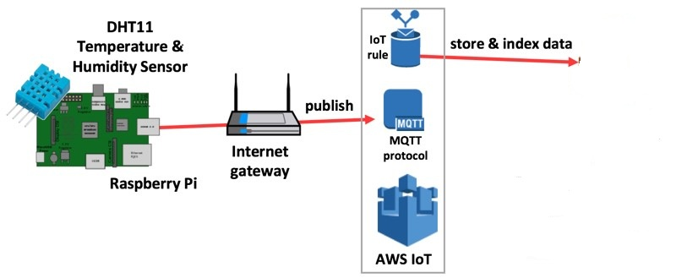
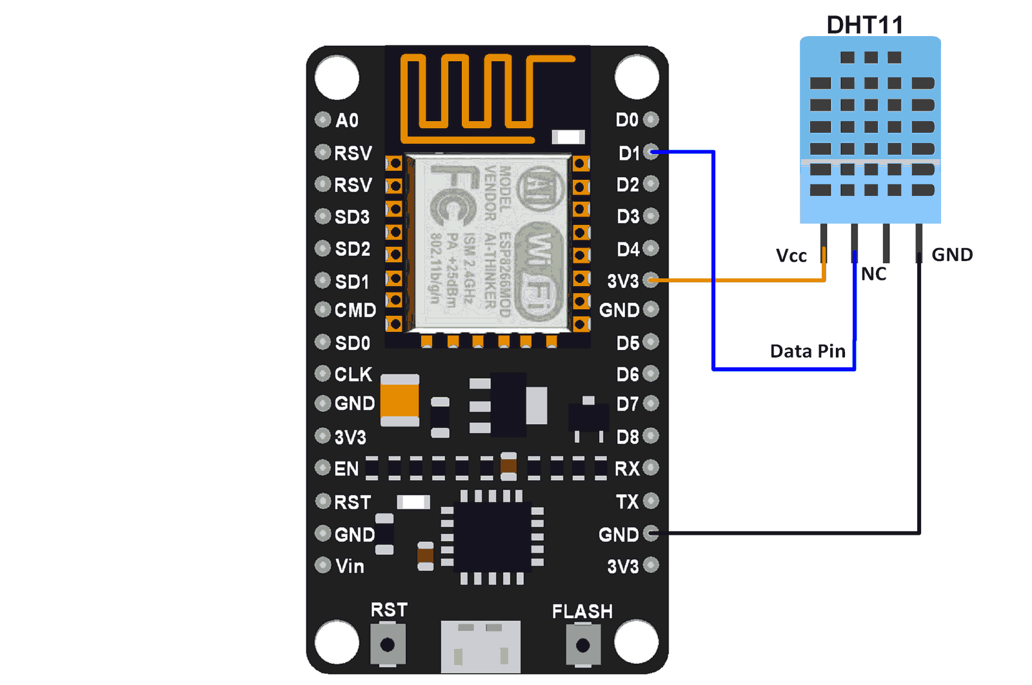
IOT BLOCK DIAGRAM

Slide 24
:
MQTT PROTOCOL
MQTT means Message Queuing Telemetry Transport. It is small size, light weight, low power usage, minimized data packets and ease of implementation .it is used for “machine-to-machine” connection.
Working:
MQTT is based on clients and a server. The server is the one who is responsible for handling the client’s requests of receiving or sending data between each other. MQTT server is called a broker and the clients are simply the connected devices.
When a device (a client) wants to send data to the broker, we call this operation a “publish”.
When a device (a client) wants to receive data from the broker, we call this operation a “subscribe”.
Publish, is the process a device does to send its message to the broker.
Subscribe, where a device does to retrieve a message from the broker.

Slide 25
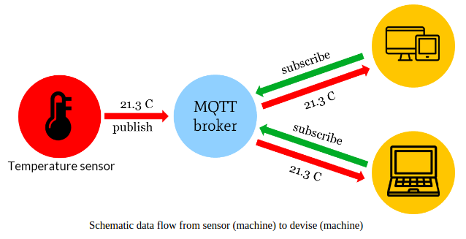
Sending sensor data to client through MQTT protocol:
The data such as temperature and humidity values from publisher is send to the mqtt broker . The broker role here is to take the message “temperature value” and deliver through a message to the subscriber phone or application.

Slide 26
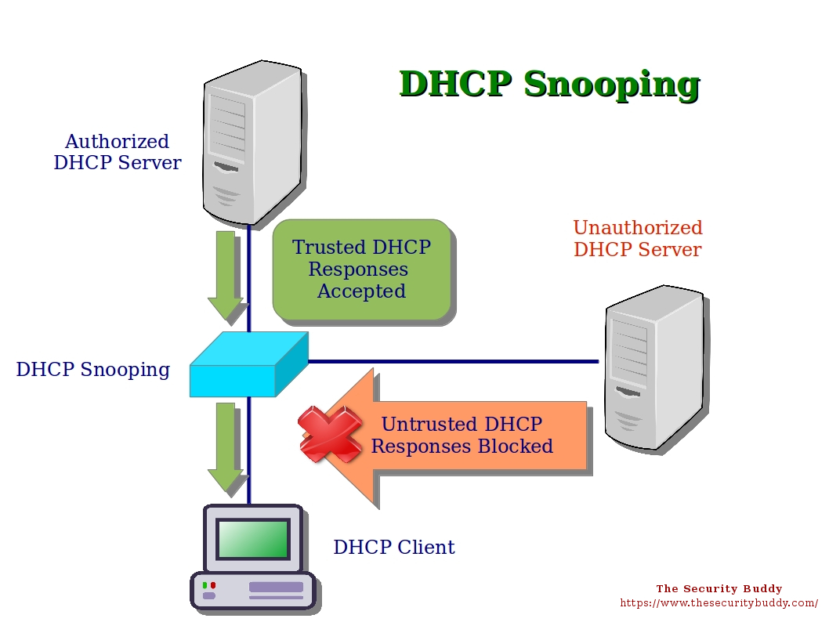
Network Security
Dhcp Snooping

Slide 27
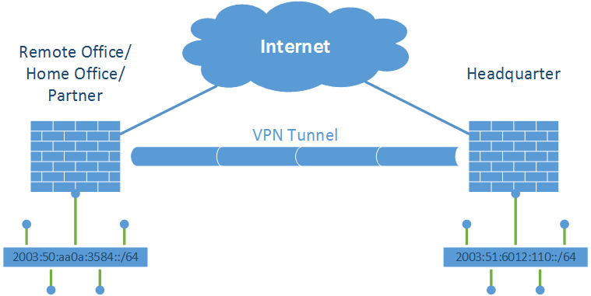
Cont
Site to Site VPN

Slide 28
Site-to-Site IPSec VPN Tunnels are used to allow the secure transmission of data, voice and video between two sites (e.g offices or branches).
The VPN tunnel is created over the Internet public network and encrypted using a number of advanced encryption algorithms to provide confidentiality of the data transmitted between the two sites.
These steps are: ○ (1) Configure ISAKMP (ISAKMP Phase 1) ○ (2) Configure IPSec (ISAKMP Phase 2, ACLs, Crypto MAP)

Slide 29

Cont
Secure Boot Sequence
The configuration file in the primary boot set is a copy of the running configuration that was in the router when the feature was first enabled
D The feature secures the smallest working set of files to preserve persistent storage space. No extra space is required to secure the primary IOS image file.
The feature automatically detects image or configuration version mismatch. Only local storage is used for securing files
The feature can be disabled only through a console session
R1# erase startup-config
Erasing the nvram filesystem will remove all configuration files! Continue? [confirm]

Slide 30
Cont..
Port Security
Port security controls how many MAC addresses can be learned on a single switch port.This also protects against malicious applications that may be sending thousands of frames
into the network, with a different bogus MAC address for each frame.
Dynamic Arp Spoofing
ARP provides IP communication within a Layer 2 broadcast domain by mapping an IP address to a MAC address.
DAI is a security feature that validates ARP packets in a network. DAI intercepts, logs, and discards ARP packets with invalid IP-t o -MAC address bindings.
This capability protects the network from some man-in-the-middle attacks.

Slide 31
What is the ASA?
Adaptive Security Appliance - Cisco’s lead dedicated firewall solution.
A firewall is a device (or software feature) designed to control the flow of traffic into and out-of a network.
In general, firewalls are installed to prevent attacks.
Protect a wide range of machines from general probes and many attacks.
Provides some protection for machines lacking in security.
Blocks packets based on:
Source IP Address or range of addresses.
Source IP Port
Destination IP Address or range of addresses.
Destination IP Port
Some allow higher layers up the OSI model.
Other protocols (How would you filter DecNET anyway?).

Slide 32
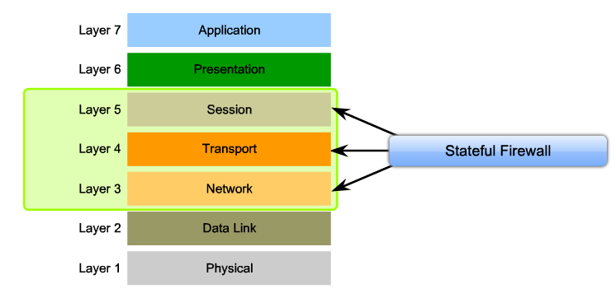
Stateful Firewall
Also monitors the state of connections
Initiation, data transfer, termination
Can detect abnormal connection behavior that might indicate attacks or exploits.

Slide 33



The ASA Stateful Firewall implementation
“DMZ “
Security Level 50
“outside”
Security Level 0
“inside”
Security Level 100
E0/2
E0/1
Internet
E0/3
Only certain connections get inspected
The administrator configures the levels of security for each interface

Slide 34
APPLICATIONS
Browser(To access AWS web Console)
Putty
Filezilla
Packet Tracer
GNS

Slide 35
CONCLUSION
Website will be handled billion and million request with out any latency and unviability issue.
By the help of Scaling feature.
Atmosphere details of particular location are obtained by the help of IoT.
On premises network secured by using principles, VPN, firewall.

Slide 36
FUTURE WORK
IPS
DB Migration to Cloud

Slide 37
REFERENCES
AWS DOCUMENTATION from aws website
CISCO DOCUMENTATION form cisco website

Slide 38


